Slide 1
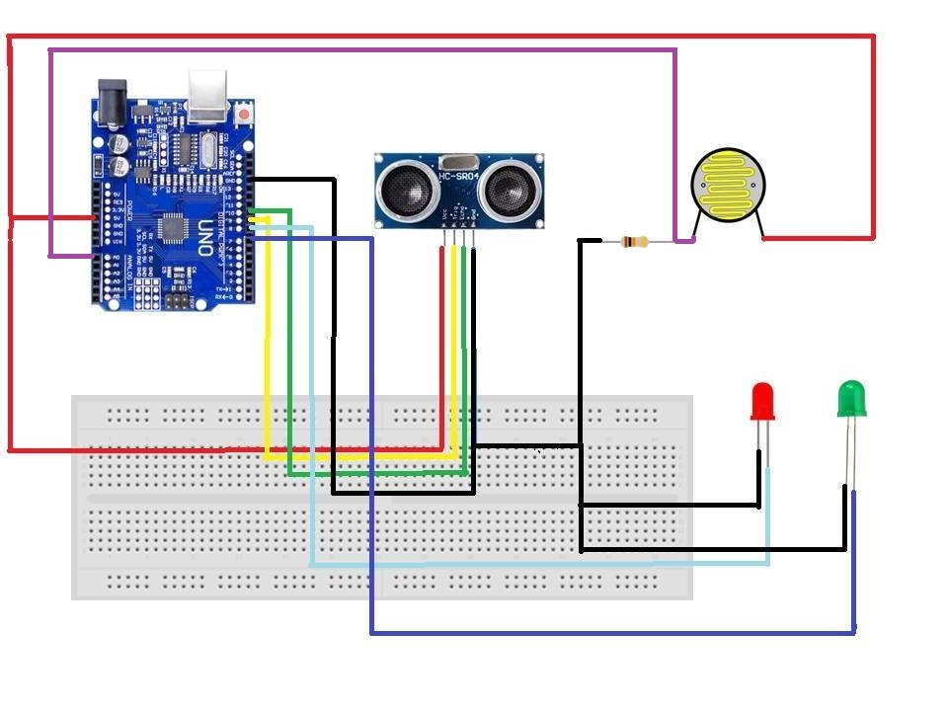
Ultra Sonic Sensor
10k ohm resistor
Light Dependent
Resistor
Arduino
Red
represents high beam
Green represents
low beam

